Slide 1
Analyzing the results of a spectrophotometry-based proliferation assay
a tutorial by Cypress Tomaneng
May 2, 2024

Slide 2
Some proteins of interest in pancreatic cancer
Retinoic Acid Induced 14 (RAI14, or ankycorbin)
Associates with the actin cytoskeleton (Peng et al., 2000)
Is overexpressed in gastic cancer tissue (He et al., 2018)
Fibronectin
Is an extracellular matrix (ECM) protein
Promotes drug resistance in pancreatic cancer (Amrutkar et al., 2019)
Collagen I
Is an ECM protein
Promotes metastasis of pancreatic cancer (Shintani et al., 2006)

Slide 3
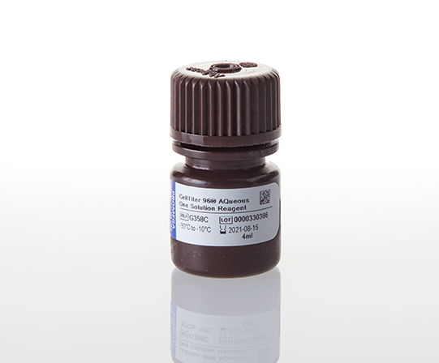
The AQueous One assay measures cell proliferation
Seed cells on well plate
Wait for proliferation
Add tetrazolium-based reagent
Take absorbance measurements with spectrophotometer
Endo et al. (2018)
Image: ProMega

Slide 4
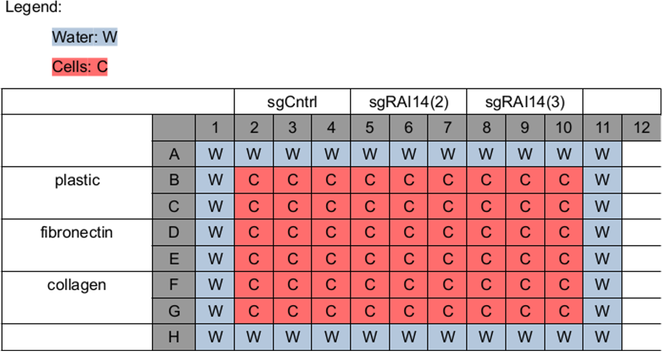
Plate layout
Notes:
Rows C, E & G also have drug treatments that I’ll be ignoring for the sake of simplicity & time here.

Slide 5
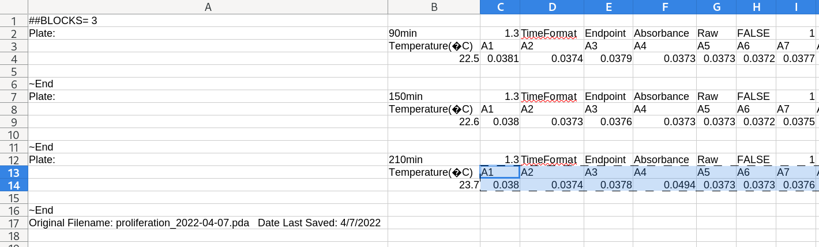
The data format
Notes:
SoftMax Pro, which comes with the spectrophotometer I used, exports data in a very wonky version of the tab separated values format, with empty columns and invalid Unicode. Copying and pasting from spreadsheet software is much simpler than automating a solution.

Slide 6
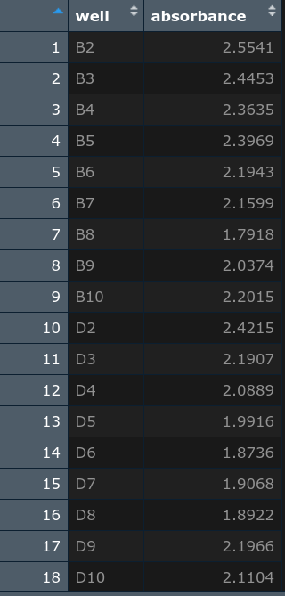
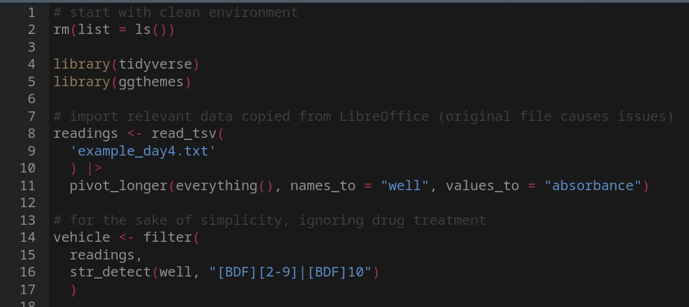
Loading in the data

Slide 7
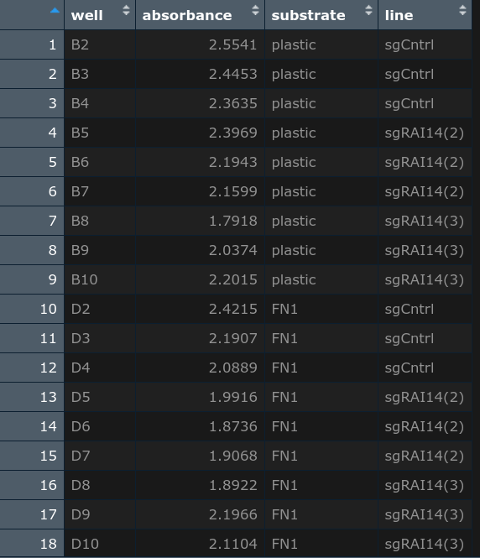
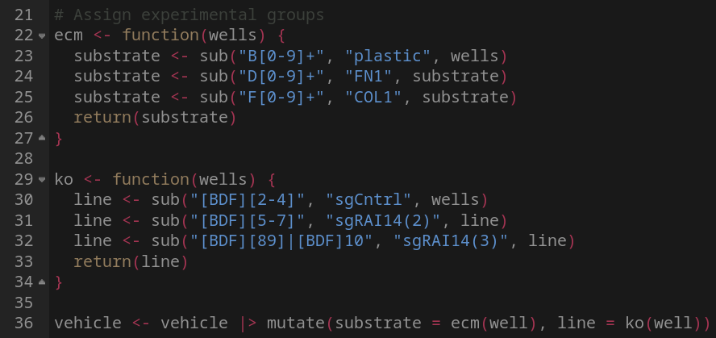
Assigning experimental groups

Slide 8
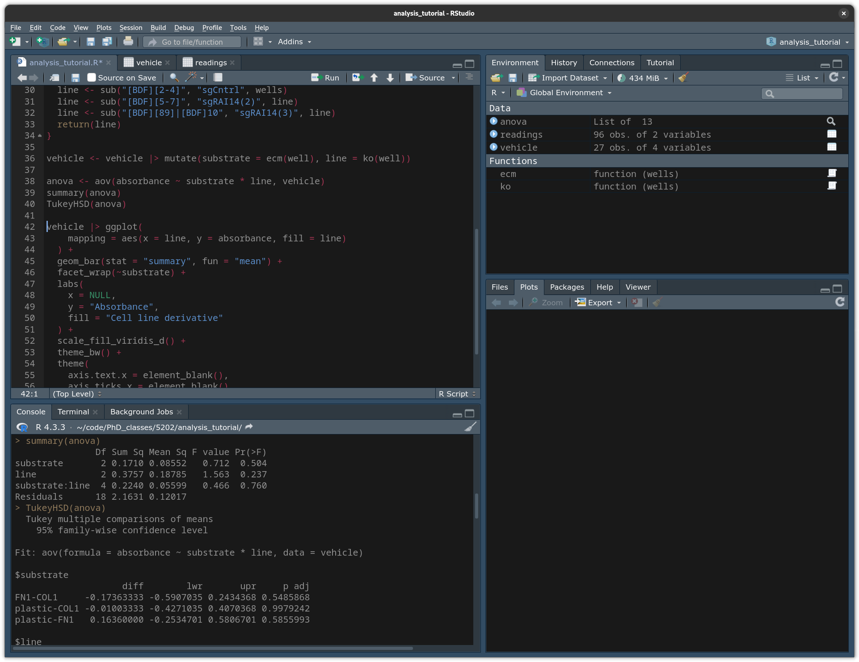
Statistical Analysis: Analysis of Variance & Tukey’s Honestly Significant Difference
Notes:
Not a single p value was below 0.05. One would hope for more interesting results.

Slide 9
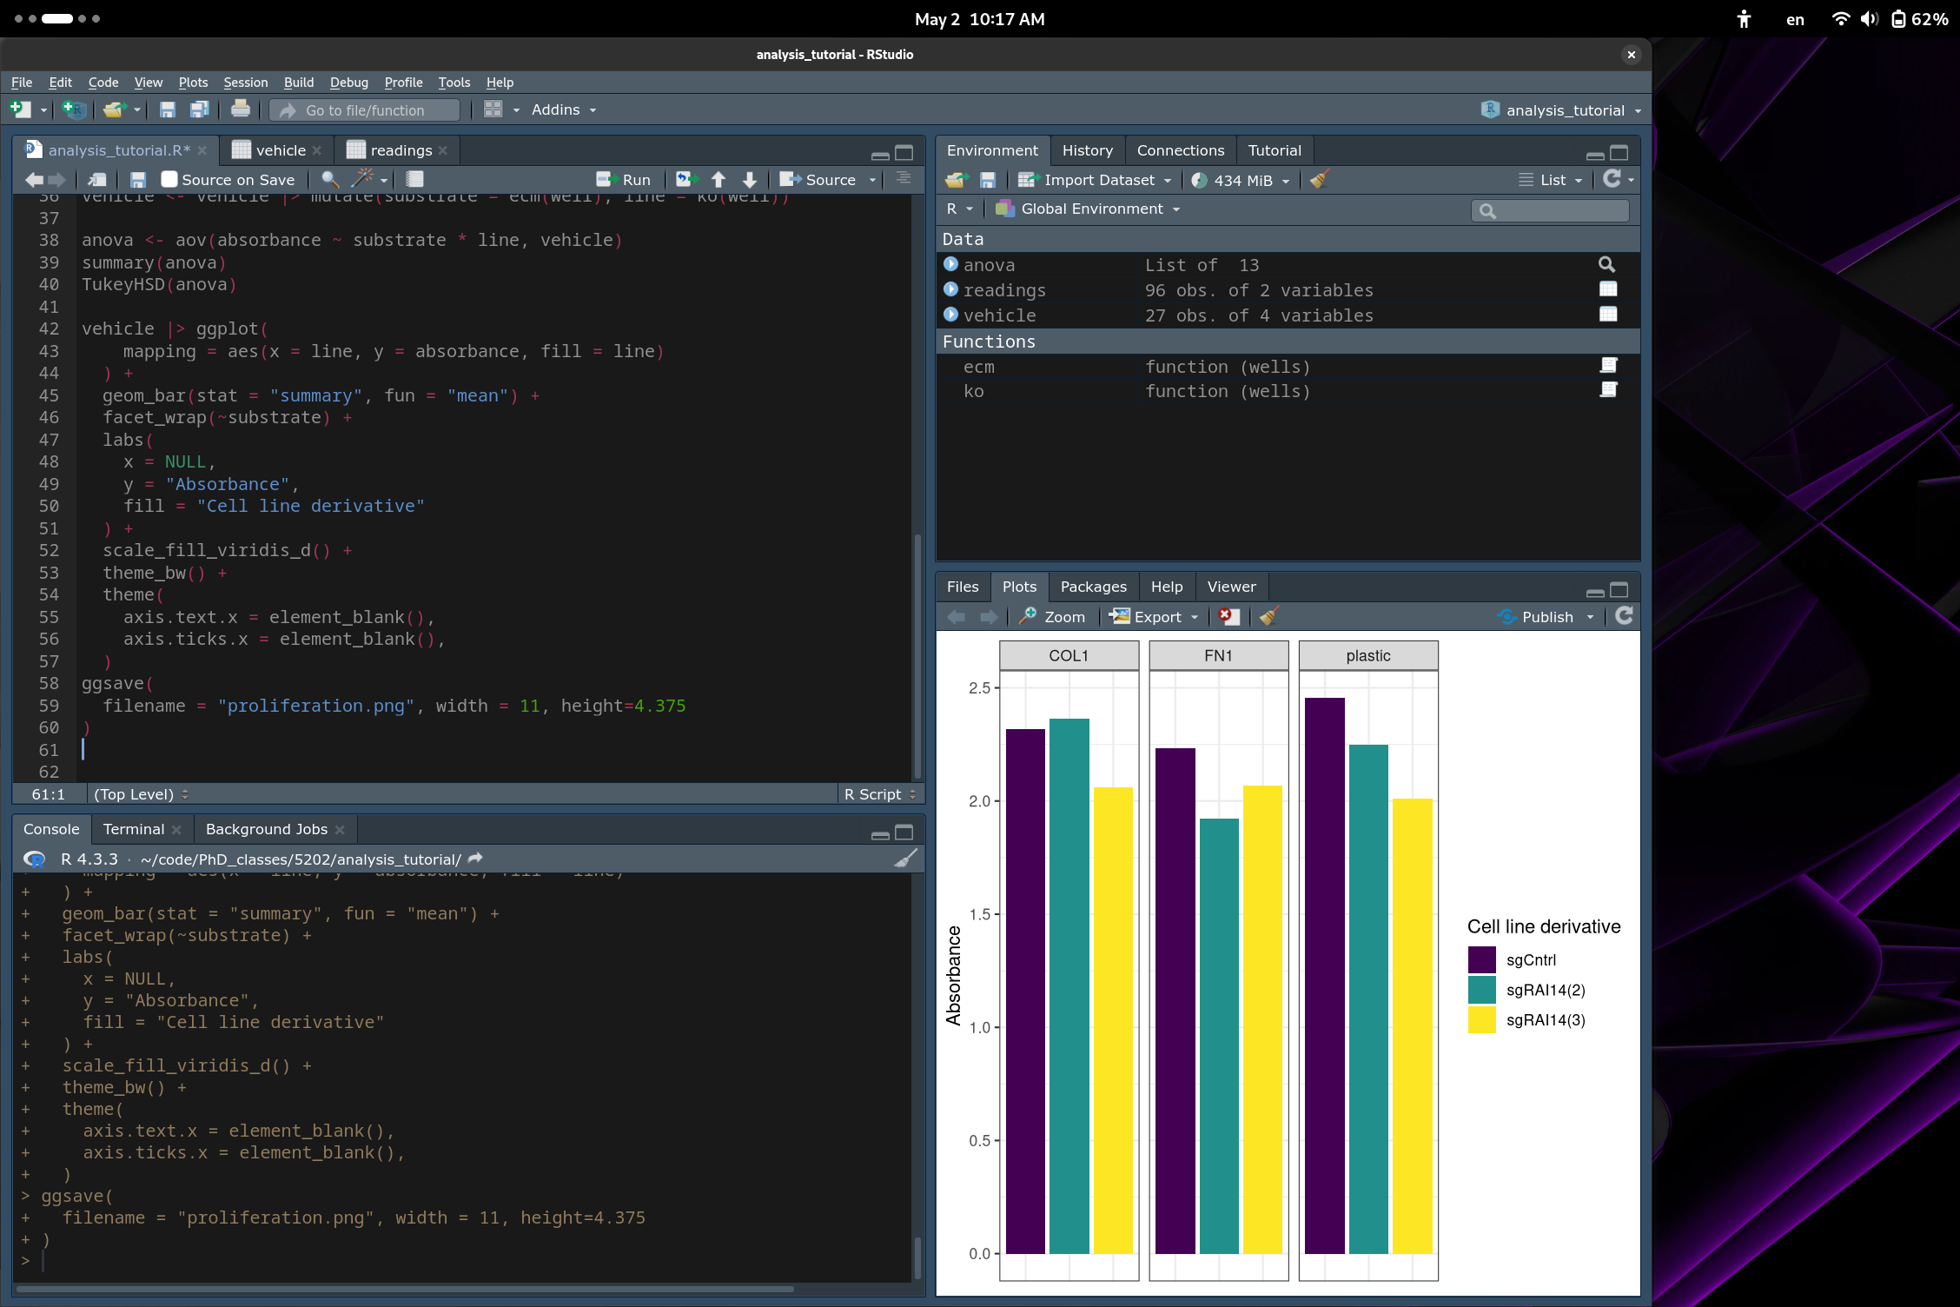
Generating the plot

Slide 10
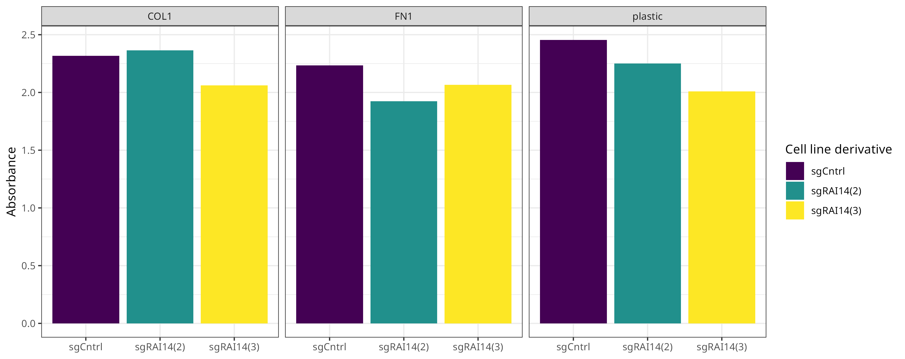
Final plot of Aqueous One assay results

Slide 11
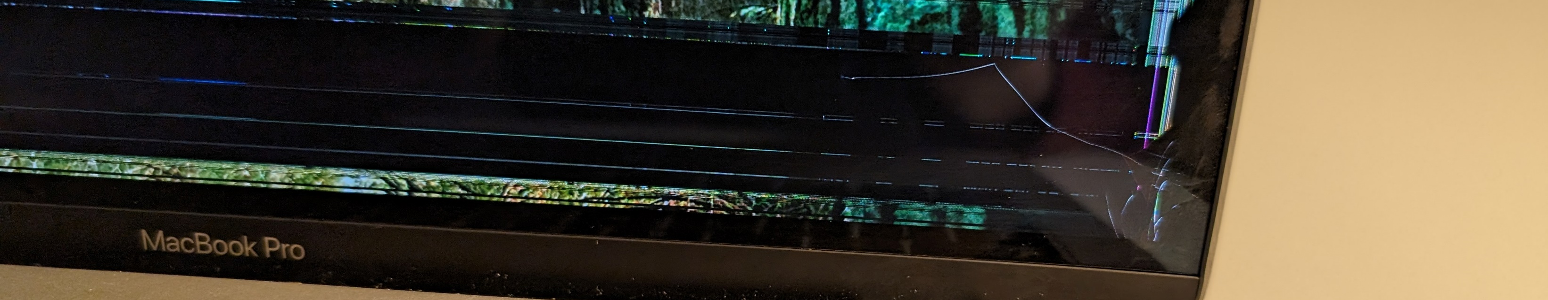
Project challenges & final notes
I broke my computer (see above).
ggsave() seems to ignore element_blank()
What if you want…
Error bars? See Winston Chang’s R Cookbook (Chang, n.d.).
Significance indicators? Try the ggsignif package.

Slide 12
References
Peng, Y., Mandai, K., Sakisaka, T., Okabe, N., Yamamoto, Y., Yokoyama, S., Mizoguchi, A., Shiozaki, H., Monden, M., & Takai, Y. (2000). Ankycorbin: A novel actin cytoskeleton‐associated protein. Genes to Cells, 5(12), 1001–1008. https://doi.org/10.1046/j.1365-2443.2000.00381.x
He, X.-Y., Zhao, J., Chen, Z.-Q., Jin, R., & Liu, C.-Y. (2018). High Expression of Retinoic Acid Induced 14 (RAI14) in Gastric Cancer and Its Prognostic Value. Medical Science Monitor, 24, 2244–2251. https://doi.org/10.12659/MSM.910133
Endo, H., Owada, S., Inagaki, Y., Shida, Y., & Tatemichi, M. (2018). Glucose starvation induces LKB1-AMPK-mediated MMP-9 expression in cancer cells. Scientific Reports, 8(1), 10122. https://doi.org/10.1038/s41598-018-28074-w
Amrutkar, M., Aasrum, M., Verbeke, C. S., & Gladhaug, I. P. (2019). Secretion of fibronectin by human pancreatic stellate cells promotes chemoresistance to gemcitabine in pancreatic cancer cells. BMC Cancer, 19(1), 596. https://doi.org/10.1186/s12885-019-5803-1
Shintani, Y., Hollingsworth, M. A., Wheelock, M. J., & Johnson, K. R. (2006). Collagen I Promotes Metastasis in Pancreatic Cancer by Activating c-Jun NH2-Terminal Kinase 1 and Up-regulating N-Cadherin Expression. Cancer Research, 66(24), 11745–11753. https://doi.org/10.1158/0008-5472.CAN-06-2322
Wickham, H., Cetinkaya-Rundel, M., & Grolemund, G. (n.d.). R for Data Science (2nd ed.). O’Reilly.
Chang, W. (n.d.). Plotting means and error bars (ggplot2). Cookbook for R. http://www.cookbook-r.com/Graphs/Plotting_means_and_error_bars_(ggplot2)/

